Slide 1
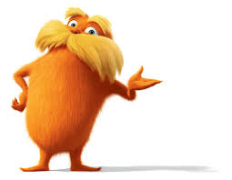
Building Stakeholders Through Service Learning
Julie Sartorius- jsartorius@cfci.net
Lori Roy- lori.roy@cfci.net
Presentation located : http://cfci.net/charter-school-conference-presentation/
Notes:
6th Grade animoto video: http://animoto.com/play/xBOrzKoIw5ldbzjy1xTOag

Slide 2
Cape Fear Center for Inquiry
Founded in 2000
K-8 School – 400 students and 28 teachers
New building/new community
Inquiry Based
Learn. Share. Live.
Social Curriculum
Community orientation
ADD MISSION
Notes:
Lori

Slide 3
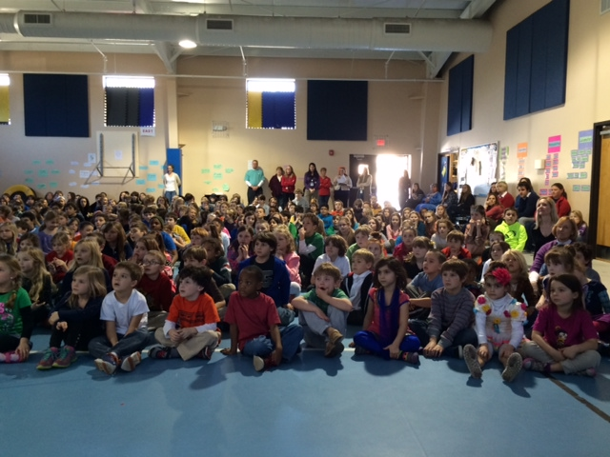
Building community ties through…
Share Month
Notes:
Julie- Share Month- A month long organized event where each grade level was partnered with a local business and non profit organization to serve a need in our community. We started with a pep rally to introduce the idea to the community with guest speakers from the partnering non profits and were able to tie in our OBOC book of the year “The Lorax” with an overarching theme of “Unless,” UNLESS someone like you cares a whole awful lot, nothing is going to get better. It's not.”

Slide 4
Building Excitement With Student investment
Notes:
Lori-Our seventh grade students created a video to build student excitement and buy in from the community.

Slide 5
Notes:
Julie

Slide 6
Business Partnerships
Notes:
Lori- talk about idea and ideals v/s bombs (trader joes- awesome! Curricular integration, highly involved with project and community, benefited already with Great Art donations), Others like Walmart and Lowes ended up just donating materials for the projects, WPD is a great connection and certainly a relationship we want to foster. Coldwell Banker parents participated, but would like to see bigger. Frustrations---coordinating the dates with the businesses, organizations and school

Slide 7
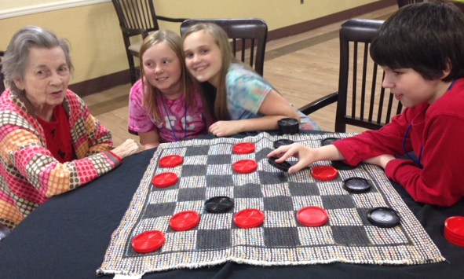
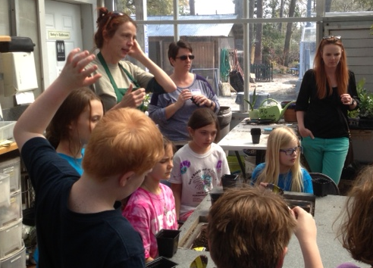
Nonprofit Partnerships
Service Learning Partnerships
Wilmington Health and
Rehabilitation Center
The Carousel Center
New Hanover County Arboretum
Airlie Gardens
Notes:
Julie

Slide 8
Share Month Celebration Night!
Whole community invited
Classes chose how to share/display their projects
Posters
Student displays
Pictures
Videos
Ability Garden plant sale
Chorus performances
Riptide Runners
Lorax Connections
PTO Bookfair Kickoff
6th Grade Video

Slide 9
How did we make it happen?
Fundraising Committee
Pre-survey to teachers
Organizations- Looked at community needs OUTSIDE of CFCI
Partner grade levels with businesses to meet those needs in the community
Business Partners (cost of supplies/projects, relationships, meet their service learning requirements, curricular ties to classroom)
Notes:
Lori-We did the work for the teachers for the most part; etc……

Slide 10
Why did we make it happen?
Business Partners- brainstorm how to get more community members involved in school fundraisers, etc. (sponsorships- financial and product donations)
Parent Board member shared about previous experiences in philanthropy with another school
Committee brainstormed-how would that look like for CFCI
Share Month is born!
Notes:
Julie

Slide 11
Feedback
Surveyed parents, community members and teachers
Key feedback
Plus: Service learning, community ties, field trips, helping OUTSIDE of CFCI, guest speakers
Ideas for improvement: More time, more notice/ publicity, more guest speakers, business communication concerns, bring in more media, make it big and bold when advertising
Notes:
Lori

Slide 12
Changes for the future….
Fall and Spring CFCI Gives Back- WEEKS
Fall month drive events
Spring outdoor give back events
Focus on different community needs in cold weather and then warmer weather
Tying to our 4th Annual Turkey Trot/food drive which is a popular community-wide event in the fall.
Sharing more information with all media outlets earlier (prepared to be a “filler” for news any time)
Continued website and social media promotion
Notes:
Julie

Slide 13
Thank you!
Questions?
Julie Sartorius- jsartorius@cfci.net
Lori Roy- lori.roy@cfci.net
CFCI Website: http://cfci.net/
Facebook: www.facebook.com/capefearcenterforinquiry
Twitter: @cfci_lori

